Slide 1
GUI for SSL
Massive Online Analysis

Slide 2
The features for Semi Supervised Classification of data streams
Data stream generators for evolving data streams.
Utilization of stream clustering algorithms in online real-time classifications.
Evaluation measures for stream clustering
Visualization the results for both classification and clustering to analyze the results and comparing different configurations.
Ability to measure and analyzing the performance of the clustering and classification models.

Slide 3
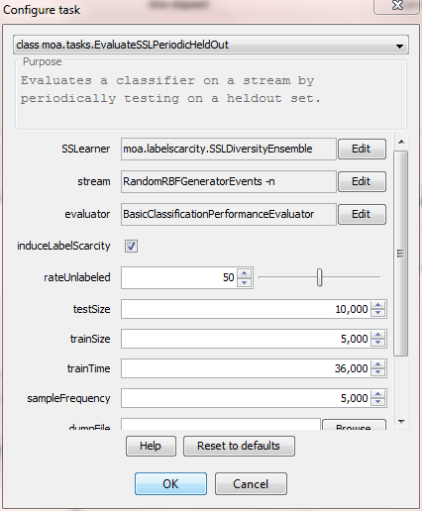
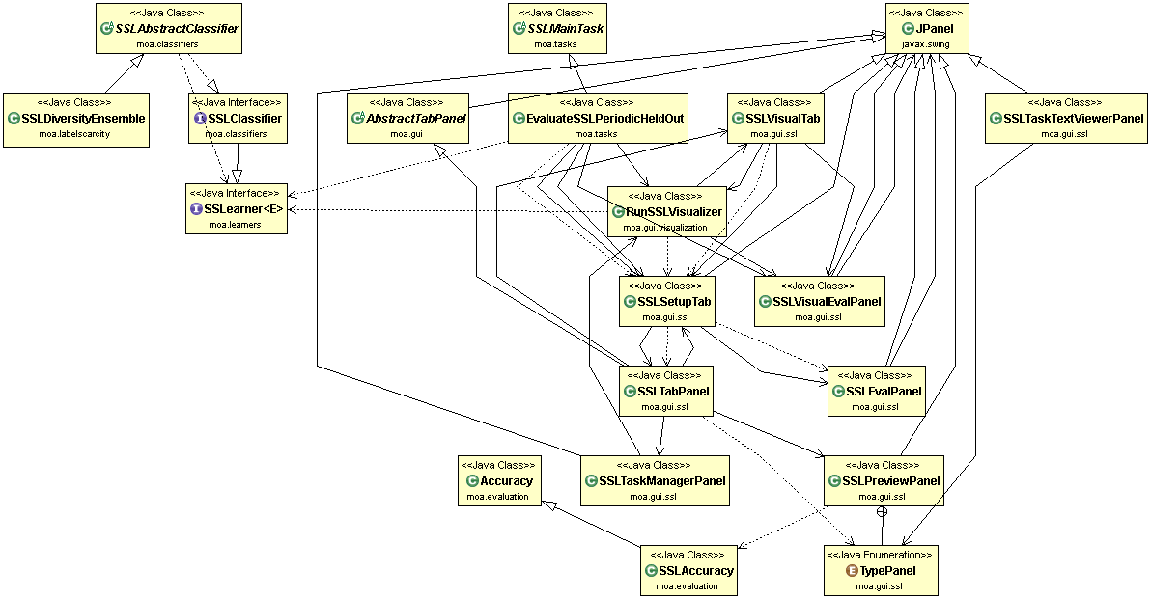
SSL_PeriodicHeldOut
Semi-Supervised
Learner
This is our HDWM algorithm
(Heterogeneous Dynamic Weighted Majority) with added clustering features

Slide 4
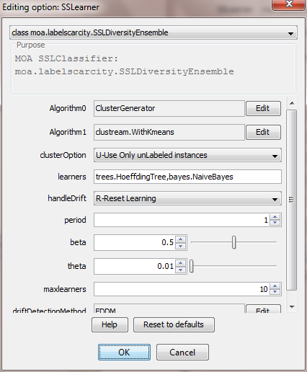
SSL_HDWM
Clustering Algorithms
Classification Algorithms

Slide 5
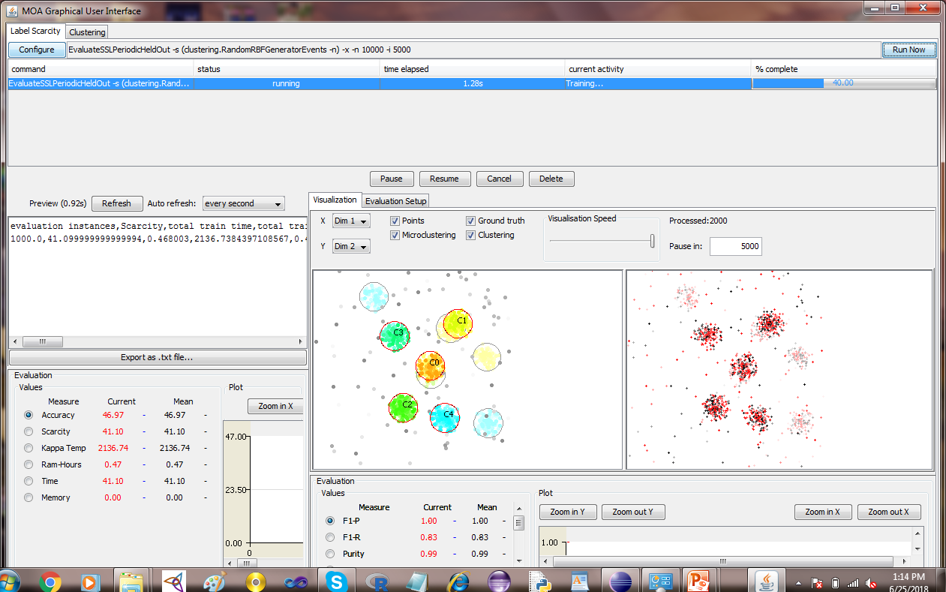
Semi Supervised Periodic Holdout Evaluation Method
Clustering
Black Dots = Scarce Labels
Label Scarcity Ratio
Prediction Evaluations
Clustering Evaluations

Slide 6
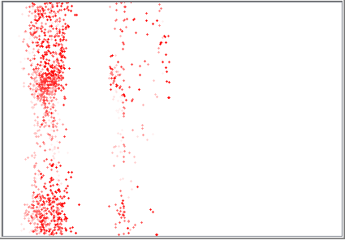
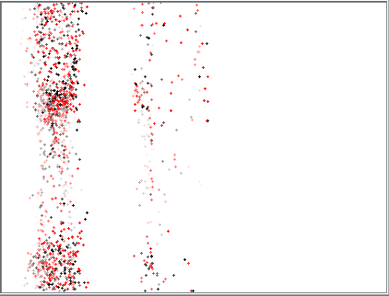
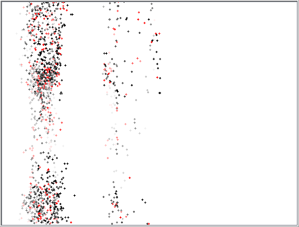
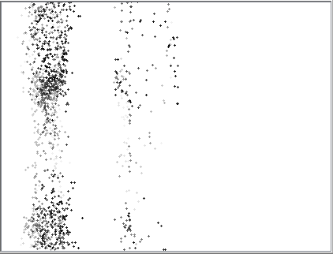
Label Scarcity Ratios
0 % scarce
50 % scarce
75 % scarce
100 % scarce

Slide 7
SSL Periodic Holdout
Training Loop
trainInst = stream.nextInstance()
InduceLabelScarcity(trainInst )
HDWM. trainOnInstance(trainInst )
visualizer.drawpoints(trainInst )
clusterer. trainOnInstance(trainInst )
End of Batch/Chunk
getClusters();
Compose Heterogeneous Ensemble
DrawClustering();
Detect concept Drift
Evaluate Clustering
Evaluate Classification
Testing Loop

Slide 8
Class Diagram

Slide 9
Source Codes

Slide 10
Function EvaluateSSLPeriodicHeldOut
/**
* Task for evaluating label scarcity classifier on a stream by periodically testing on a holdout set.
*
* @author Mobin Idrees (mmadrees@uod.edu.sa)
* @supervisor Dr. Frederic Stahl (f.t.stahl@reading.ac.uk)
* @version $Revision: 6 $
*/
public class EvaluateSSLPeriodicHeldOut extends SSLMainTask {
// initialize variables
// Training Begin
while (instancesProcessed < this.trainSizeOption.getValue()) {
//batch or chunk loop
while (instancesProcessed < instancesTarget && stream.hasMoreInstances() == true) {
InduceLabelScarcity(scarsetrainInst,instancesProcessed);
SSLearner.trainOnInstance((Example) scarsetrainInst);
if (monitor.resultVisualRequested())
visualizer.drawpoints(scarsetrainInst,instancesProcessed);
// End of batch or chunk loop
pointarray0=SSLearner.getCluster();
gtClustering0 = SSLearner.gtClustering0(pointarray0);
macro0 = SSLearner.gtmacro0(gtClustering0);
evalClustering0 = macro0;
evaluateClustering(evalClustering0, gtClustering0, pointarray0);
visualizer.drawClusterings(SSLearner);
}
// Testing Begin
double[] prediction = SSLearner.getVotesForInstance(testInst);
evaluator.addResult(testInst, prediction);
}

Slide 11
Function InduceLabelScarcity
protected void InduceLabelScarcity(Example<Instance> scarsetrainInst, long epochs) {
Instance inst = scarsetrainInst.getData();
prob = Math.random()%100;
if ( prob >= (double) this.m_dUlRate.getValue()/100 && inst.classIsMissing() == false)
((Instance) scarsetrainInst.getData()).setScarceLabel(false);
((Instance) scarsetrainInst.getData()).setScarceLabel(true);
unLabeledCount++;;
Function DoClustering
private void DoClustering(Instance inst, long timestamp) {
// m_clusterer.trainInstance(Instance)
DataPoint point0 = new DataPoint(inst,(int) this.epochs);
pointBuffer0.add(point0);
while(pointBuffer0.size() > m_stream0_decayHorizon){
pointBuffer0.removeFirst();
}
Instance traininst0 = new DenseInstance(point0);
if(m_clusterer0.keepClassLabel())
traininst0.setDataset(point0.dataset());
else
traininst0.deleteAttributeAt(point0.classIndex());
m_clusterer0.trainOnInstanceImpl(traininst0);
}

Slide 12
Function SSLAbstractClassifier.getCluster
@Override
public ArrayList<DataPoint> getCluster() {
for(DataPoint p:pointBuffer0)
p.updateWeight((int) this.epochs, m_stream0_decay_rate);
// transfer pointbuffer to pointArray
pointarray0 = new ArrayList<DataPoint>(pointBuffer0);
return pointarray0;
}
Function SSLAbstractClassifier.initialize()
@Override
public void Initialize(ClusteringStream m_stream0) {
m_stream0_decayHorizon = m_stream0.getDecayHorizon();
m_stream0_decay_threshold = m_stream0.getDecayThreshold();
m_stream0_decay_rate = (Math.log(1.0/m_stream0_decay_threshold)/Math.log(2)/m_stream0_decayHorizon);
}

Slide 13
Function SSL_HDWM_Ensemble
/**
* Semi-Supervised Diversity Ensemble
* Heterogeneous Learning in Label Scarcity.
*
* Uses multiple kind of seed Learners
* @author Mobin Idrees (mmadrees@uod.edu.sa)
* @supervisor Dr. Frederic Stahl (f.t.stahl@reading.ac.uk)
*/
public class SSLHDWMEnsemble extends SSLAbstractClassifier implements MultiClassClassifier {
// Clustering option
public ClassOption algorithmOption1 = new ClassOption("Algorithm1", 'a',
"Comparison algorithm", Clusterer.class, "clustream.WithKmeans");
// Base Classifiers option
public ListOption learnerListOption = new ListOption(
"learners",'l',"The learners to combine.", new ClassOption("learner", '', "", Classifier.class,
"trees.HoeffdingTree"), new Option[]{ new ClassOption("", '', "", Classifier.class,
"trees.HoeffdingTree"), new ClassOption("", '', "", Classifier.class, "bayes.NaiveBayes")},
',');
public void trainOnInstanceImpl(Instance inst) {
DoClustering(inst, epochs);
// Loop over learners
for (int i = 0; i < this.learners.size(); i++) {
double[] pr = this.learners.get(i).getVotesForInstance(inst);
int yHat = Utils.maxIndex(pr);
...
//call the Global Drift Detection Method
this.driftDetectionGlobal.input(prediction ? 0.0 : 1.0);
...

Slide 14
Algorithm’s Evaluation
Stream: RandomRBFGeneratorEvents
Induce Scarcity Flag= x
Scarcity Rate(r) = 50%
Train Size(i) = 5,000
Test Size(n) = 10,000
Frequency(f) = 1000
MOA Command:
EvaluateSSLPeriodicHeldOut -s (RandomRBFGeneratorEvents -n) -x -r 50 -n 10000 -i 5000 –f 1000

Slide 15
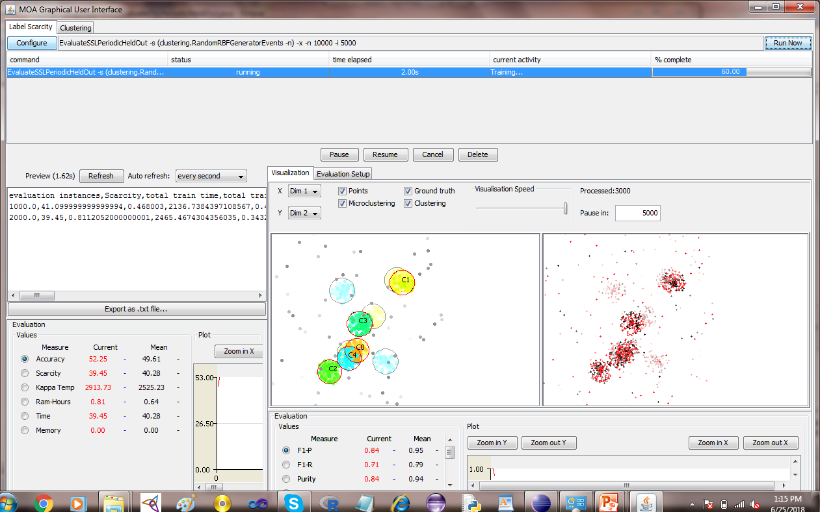

Slide 16
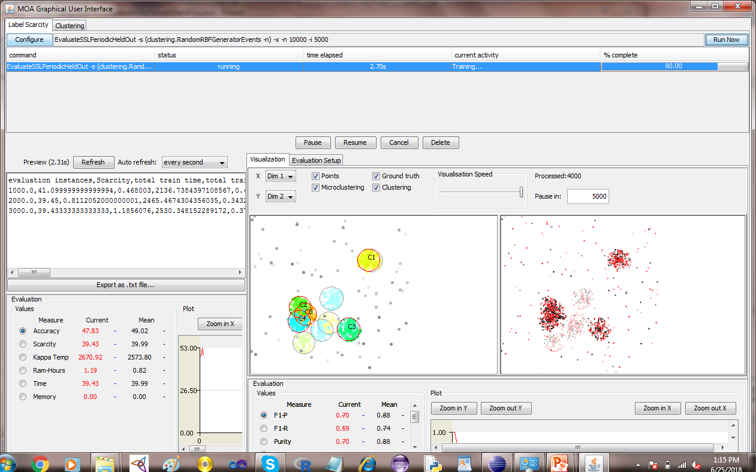

Slide 17
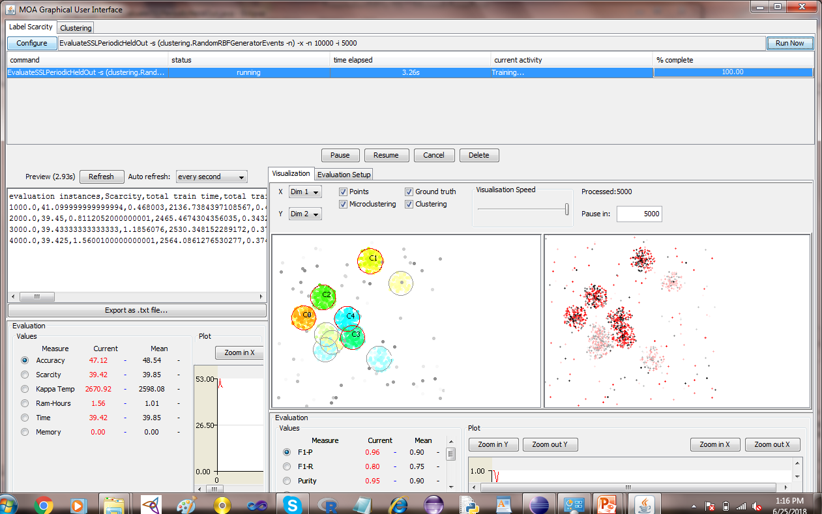

Slide 18


Slide 19
Benchmark for Evaluation
DataStream: CoverTypeNorm
The dataset contains 581,012 instances, 54 numerical attributes and 7 classes
Predicts forest cover type using cartographic variables
The forest cover type for 30x30 meter cells collected by the US Forest Service

Slide 20
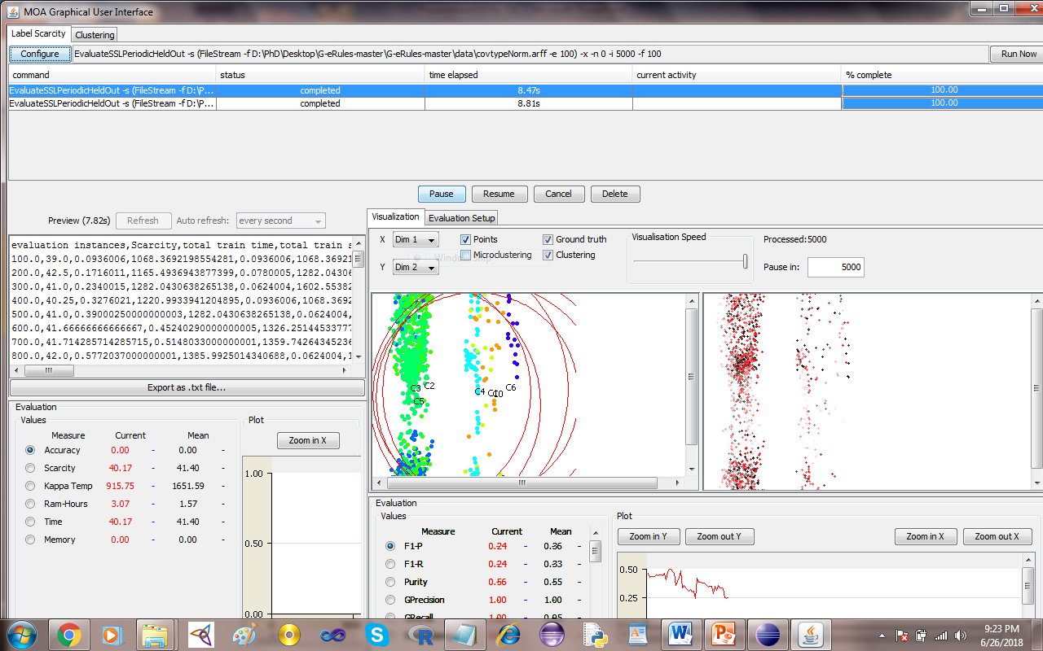
Semi Supervised Learning: CoverTypeNorm

Slide 21
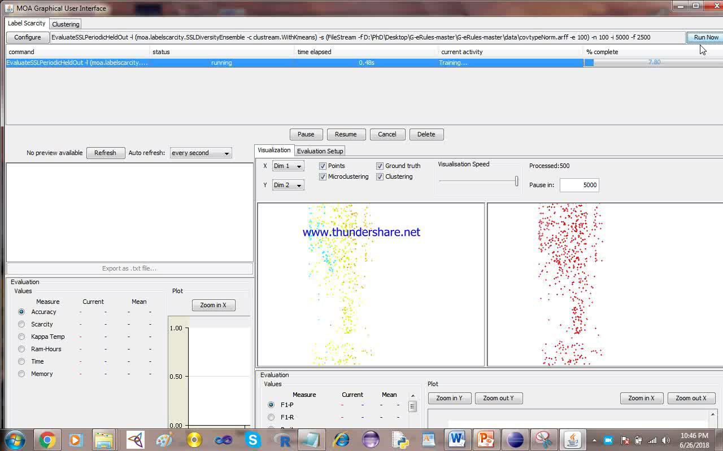
Video
Semi Supervised Learning: CoverTypeNorm

Slide 22
MOA Command
EvaluateSSLPeriodicHeldOut -l (moa.labelscarcity.SSLDiversityEnsemble -c clustream.WithKmeans) -s (FileStream -f D:\PhD\Desktop\G-eRules-master\G-eRules-master\data\covtypeNorm.arff -e 100) -x -r 75 -n 100 -i 5000 -f 2500

